Slide 1
Democratizing Computation: The introduction of Personal Computers
By Xavier Hale and Frank Leon

Slide 2
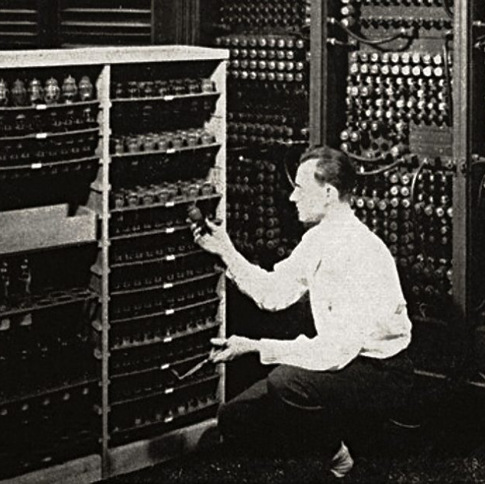
Contextualization
In the early 1950’s, computers were enormous machines that took up rooms of space and were very inefficient relative to the amounts of power they consumed. They were also difficult to use, requiring switch panels and jumper cables to input instructions. They were also self-contained, not able to interface with other computers easily. The invention of smaller, personal computers revolutionized the economy by opening new markets for business, giving rise to new companies, and allowing exchange of information at unprecedented rates.

Slide 3
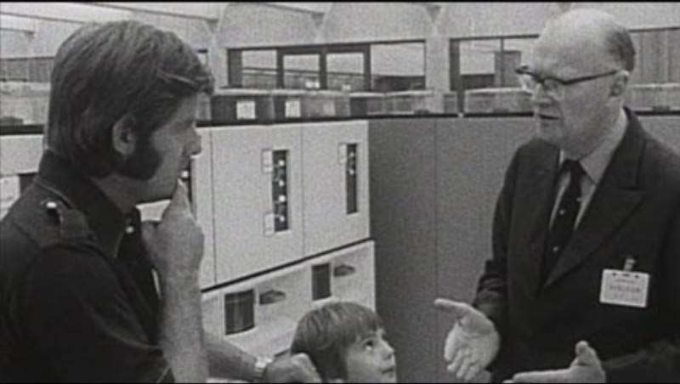
Video

Slide 4
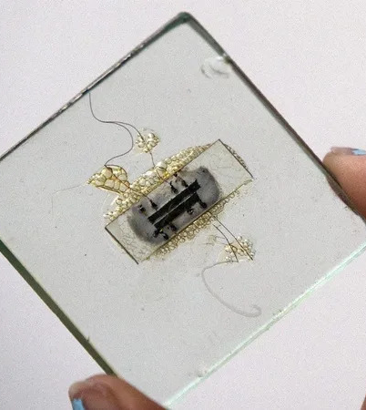
Opening of Markets
Personal computers opened many new markets and business opportunities, growing the American economy. For example, a company called Texas Instruments took of in the 1950’s from the invention of the first microchip. (Phipps 8) This invention radically shrunk the size of computers, allowing for them to be produced in higher quantities and for cheaper, driving business to computer companies.

Slide 5
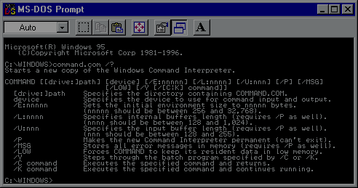
Software Companies
As the number of computers for home use increased, so did the amount of people make software for them. As the cost of personal computers came down, there were many openings for companies to come in and produce software for them, as computers are effectively useless without it. The competitive nature of this drove many businesses to success. (Steinmueller 7)

Slide 6
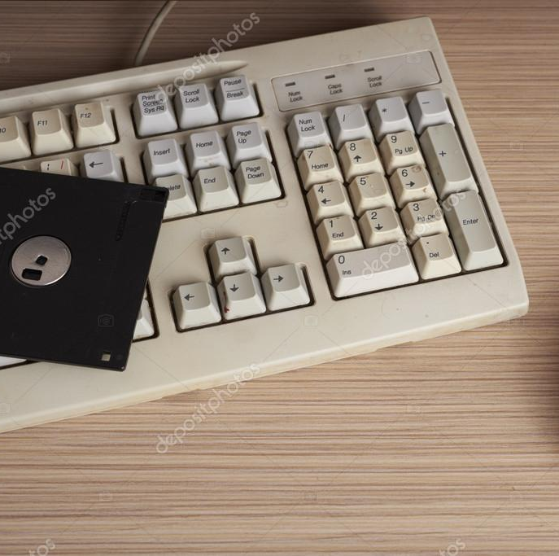
Peripherals
With computers becoming prevalent in most people’s homes, accessories to computers started to be produced as well. Keyboards, mice, monitors, storage disks, all needed to be produced to keep computer ecosystems alive. (Langolis 1) Many businesses took advantage of the open architecture of the computers of the time, producing all manner of peripherals.

Slide 7

PC’s and the Stock Market
The implementation of personal computers brought to the nation great economic changes via increasing the speed of information exchange. For example, the stock market consisted of manual, paper heavy work which could only be done by professionals, shifting to a digitalized economic practice that could be done by the masses. The rapid exchange of information allowed investors to increase speed and volume of trading, allowing the number of owned shares to expand resulting in economic expansion.

Slide 8

Online Shopping
As computers came around, so did a way to connect them, the Internet. The internet opened many opportunities in the world of business, one of which was online shopping. During the late 90’s , the growth of the amount of people with personal computers as well as the dot-com bubble at the time created many successful businesses such as Amazon and eBay that we still use today. (Lieberman 18).

Slide 9

Global Interaction
With the advent of Personal Computers and the general public’s access to the internet came improvements in international trade. Consumers gained the ability to purchase and sell things to people halfway across the globe with just a few clicks. Consequently, the global market became instantly accessible, allowing buyers and sellers to execute international agreements with a single click rather than enduring the weeks of logistical coordination previously required.

Slide 10
Works Cited
Steinmueller, Edward. “The U.S. software industry : an analysis and interpretative history” Maastricht Economic Research Institute in Innovation and Technology. January 1995. https://cris.maastrichtuniversity.nl/ws/portalfiles/portal/1350625/guid-b1d2735f-8c10-4967-8cc2-51336daa7955-ASSET1.0.pdf
C. Phipps, "The Early History of ICs at Texas Instruments: A Personal View" in IEEE Annals of the History of Computing, vol. 34, no. 01, pp. 37-47, Jan.-March 2012, doi: 10.1109/MAHC.2011.84
https://doi.ieeecomputersociety.org/10.1109/MAHC.2011.84
https://www.academia.edu/97405754/External_Economies_and_Economic_Progress_The_Case_of_the_Microcomputer_Industry
Lieberman, Marvin B. "Did First-Mover Advantage Survive the Dot-Com Crash?" UCLA Anderson School of Management, Dec. 2007.

